Slide 1
DSA Self-paced summer internship course by GeeksForGeeks Course code:CSE343(Training in programming)
Name: Manish Kumar
Registration Number: 12300352

Slide 2
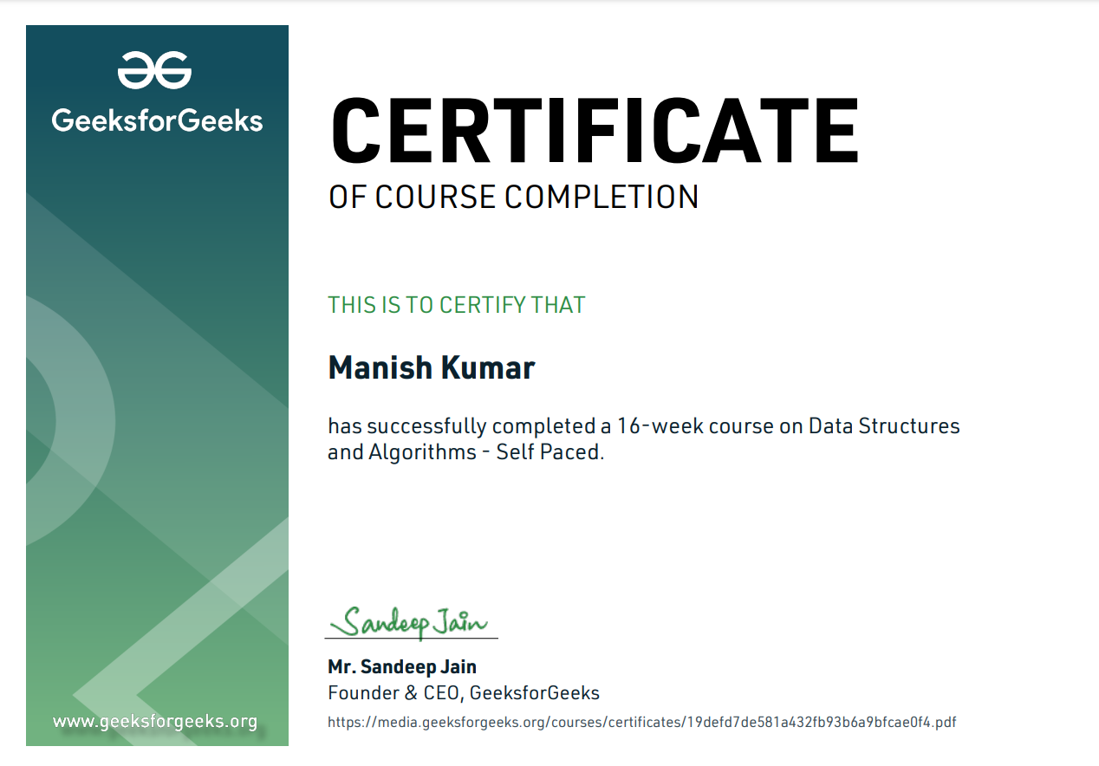

Slide 3
What is DSA?
DSA stands for data structures and algorithms. It is very important concept in computer science and web development. DSA helps us to helps you structure, store, and process data. It helps to solve real world problems. It enables you to understand the problem statements on a deeper level and create logical solutions to solve them. Using the right data structure and algorithm makes your program run faster, especially when working with lots of data.

Slide 4
Topics:
Analysis of common loops
Analysis of Recursion
Space Complexity
Arrays and Strings
Searching and Sorting
Hashing
Linked List
8. Stacks, Queues and Deque
9. Tree
10.Binary Search Tree
11. Heap
12. Graphs
13. Tree
14. Segment Tree

Slide 5
Importance of DSA:
Data Structures and Algorithms (DSA) are vital part of computer science and programming. It provides the efficient of problem-solving, enabling developers to create optimized solutions that handle large-scale data and complex computations effectively. By mastering DSA, you gain a deep understanding of core concepts like arrays, linked lists, trees, and various algorithms. Specially this course from GeeksForGeeks taught by Mr. Sandeep Jain, is perfectly designed for learners to get comfortable with it.

Slide 6
Project Description:
Tic tac toe is two-player game where participants alternate marking Xs and Os on a 3x3 grid. The objective is to align three of their symbols horizontally, vertically, or diagonally to win. The game is implemented with a user-friendly interface and includes logic to detect winning conditions or ties. It's a great introductory project for understanding basic game mechanics and programming logic. The code is modular, making it easy to expand or customize further.

Slide 7
Algorithm used in this project:
The Tic Tac Toe algorithm starts by initializing a 3x3 grid and designating "X" as the first player's symbol. The game enters a loop where players take turns selecting a cell to place their symbol, ensuring the chosen cell is empty. After each move, the grid is updated, and the game checks for a winning condition by evaluating if a player has aligned three of their symbols horizontally, vertically, or diagonally. If no win occurs, the algorithm also checks for a tie when all cells are filled. The game continues until a player wins or a tie is detected.

Slide 8
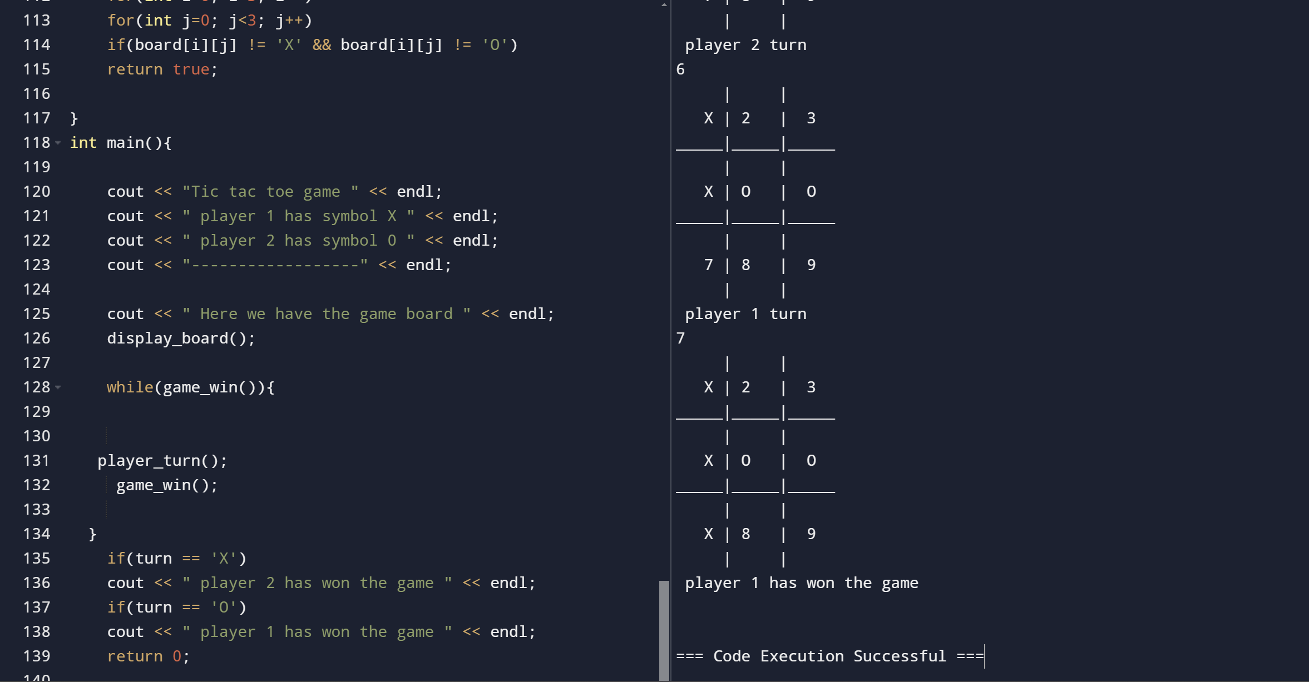

Slide 9
I would like to thank GeeksForGeeks and Mr. Sandeep Jain for this amazing course.
Thanks

